Slide 1
Coupa Supplier Portal (CSP) Training –​
Hosting Your Catalogue​
FINANCE IS OPEN

Slide 2
Contents
1
CSP Registration
4
CSP Hosted Catalogue – Updating Item Details​
2
CSP Hosted Catalogue – Introduction
5
CSP Hosted Catalogue – Approval​
3
CSP Hosted Catalogue – Creating Catalogue Items​

Slide 3
1
CSP Registration

Slide 4
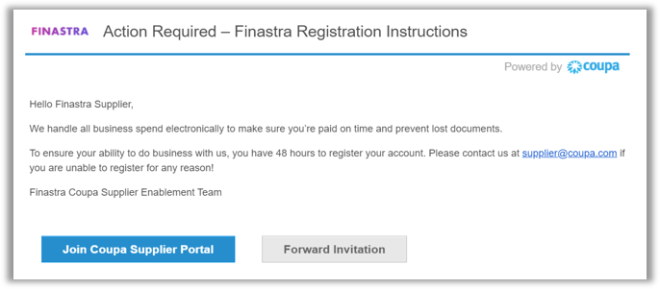
CSP Registration [1/3]
Coupa Supplier Portal Registration:
You will receive a Coupa Supplier Portal (CSP) invite from Finastra via email.
If you are a new Coupa user [1/2]:
Click “Join Coupa Supplier Portal” in your email.
After being directed to the CSP website, input the required credentials to complete your CSP registration.

Slide 5
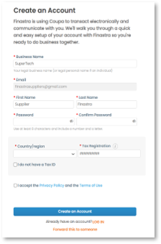
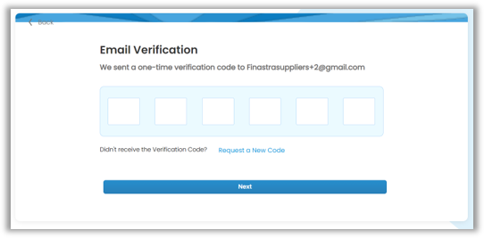
CSP Registration [2/3]
If you are a new Coupa user [2/2]:​
Input your “Business name” and create a “Password”.​
As a new Coupa user, you will also be asked to “accept the Privacy Policy and the Terms of Use” – please access via the hyperlinks and read and confirm accordingly.​
Click on “Create an Account”, which will direct you to a new page for email verification.​
Input the verification code you will have received via email, and click “Next” to access the Coupa Supplier Portal.

Slide 6
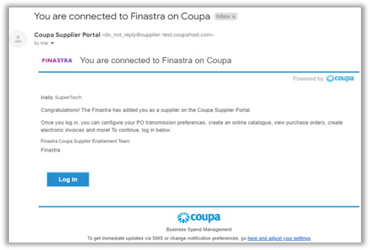
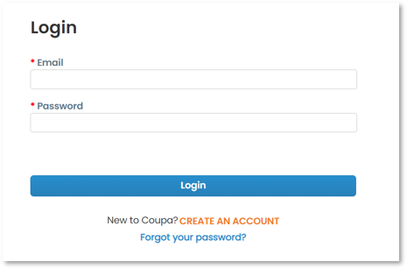
CSP Registration [3/3]
If you already have an account:​
Click “Login” to navigate to the Login page.​
Input your “Email” and “Password”, and click “Login” to access the Coupa Supplier Portal.
Please refer to 1. Setting Up CSP Account if you need any further information on how to register your CSP account.​

Slide 7
2
CSP Hosted Catalogue – Introduction

Slide 8
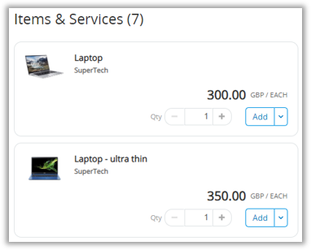
CSP Hosted Catalogue – Introduction [1/2]​
What is a CSP Hosted Catalogue?​
As a Finastra supplier, you can submit catalogues via the Coupa Supplier Portal (CSP). Once submitted, the items will go through the Finastra approval chain for catalogue validation.​
Once hosted catalogues are approved and loaded onto Coupa, Finastra users can search for and add items directly into their basket in Coupa.​
You will have visibility and control of the catalogues that are available to Finastra users – for instance, you can submit price changes for approval directly through the CSP.​
An example has been provided below of a Finastra user’s view of a purchasable catalogue in Coupa:

Slide 9
CSP Hosted Catalogue – Introduction [2/2]​
Hosting catalogues in the Coupa Supplier Portal (CSP) offers you the potential for increased sales, improved operational efficiency, better customer relationships, and access to important data.​
​
By hosting your catalogues on the CSP: ​
Your products will be readily available to buyers at Finastra, following a simplified purchasing process.​
You will have visibility and control over product details, such as pricing and availability, reducing the likelihood of having outdated or incorrect item information.​
You can make real-time catalogue updates, ensuring a smooth customer experience and avoiding the potential of error and delays.​
You can analyse sales trends, monitor customer preferences, and identify opportunities for improvement based on the data available.

Slide 10
3
CSP Hosted Catalogue – Creating Catalogue Items​

Slide 11
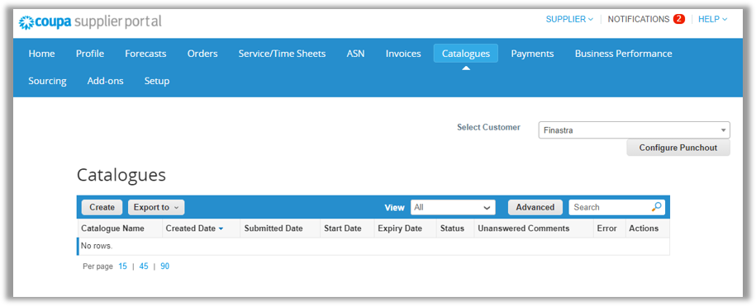
CSP Hosted Catalogue – Creating Catalogue Items [1/5]​
Step 1: Creating a Catalogue [1/2]​
To create a catalogue for Finastra users, login to your CSP account.​
On the CSP Homepage, click “Catalogues” in the menu.​
Select “Finastra” from the “Select Customer” drop-down list.​
Click on “Create”.

Slide 12
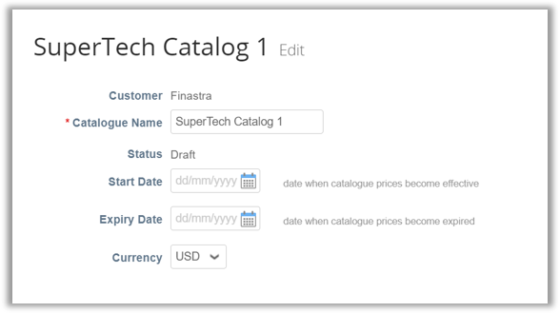
CSP Hosted Catalogue – Creating Catalogue Items [2/5]​
Step 1: Creating a Catalogue [2/2]​
You will be directed to the catalogue creation page to input key information to create the catalogue: ​
Catalogue Name: name of the catalogue.​
Start Date: date when the catalogue should start being purchasable in Coupa.​
End Date: date when the catalogue should expire in Coupa.​
Currency: the default currency of the item price.

Slide 13
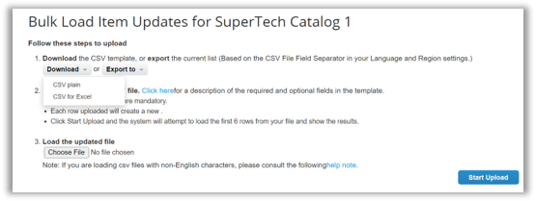
CSP Hosted Catalogue – Creating Catalogue Items [3/5]​
Step 2: Uploading Items to a Catalogue​
On the same catalogue creation page, scroll down to the “Items Included in Catalogue” section:​
Click “Load from file”.​
Click “Download” and select “CSV for Excel” in the drop down.​
Complete the CSV file with your catalogue item details – detailed instruction on populating this file can be found on Pages 14 & 15.​
Once complete, click “Choose file” – in the pop-up window, select the completed CSV file and click “Open”.​
Click “Start Upload” to upload the file.

Slide 14
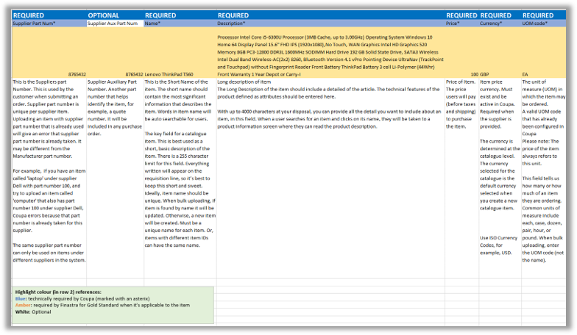
CSP Hosted Catalogue – Creating Catalogue Items [4/5]​
Key Instruction on CSV File Population [1/2]​
In the CSV file referred to on the previous page, Finastra has provided a mock example to support your catalogue item creation.​
A screenshot of the file is provided below:

Slide 15
CSP Hosted Catalogue – Creating Catalogue Items [5/5]​
Key Instruction on CSV File Population [2/2]​
Mandatory fields (required by Coupa): ​
Supplier Part Number: the unique number per supplier item.​
Name: the short name of the item.​
Description: the long description of the item.​
Price: the price of the item (excluding taxes and shipping charges).​
Currency: the item price currency.​
UOM code: the Unit of Measure of the item, e.g. EA – this will be provided by Finastra.​
Active: input “Yes” to allow the item to be purchasable, once approved by Finastra.​
UNSPSC code: the United Nations Standard Products and Services Code of the item.​
​
Finastra required field (optional by Coupa):​
Image URL: a valid and publicly accessible URL where the product image can be downloaded from.

Slide 16
4
CSP Hosted Catalogue – Updating Item Details​

Slide 17
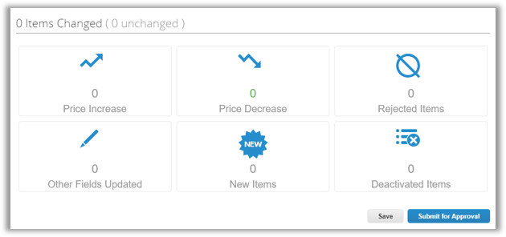
CSP Hosted Catalogue – Updating Item Details​
The Items Changed section provides information on the changes that you have made to your catalogue:​
Price Increase: number of items in the catalogue that have increased in price. ​
Price Decrease: number of items in the catalogue that have decreased in price.​
Rejected Items: number of items Finastra has rejected to publish and use in Coupa.​
Other Fields Updated: number of items with modified elements, other than a change in price.​
New Items: number of newly added items to be included in the catalogue.​
Deactivated Items: number of items which are no longer purchasable for Finastra users in Coupa.

Slide 18
5
CSP Hosted Catalogue – Approval​

Slide 19
CSP Hosted Catalogue – Approval [1/2]​
After submitting catalogue items for approval:​
You will see the status as “Pending Approval”.​
To view the approval chain, click into the item.​
To withdraw that item, use the “Withdraw” button below the approval chain.
Whilst a catalogue item is pending approval, you can also add and send comments directly to Finastra:​

Slide 20
CSP Hosted Catalogue – Approval [2/2]​
Once the catalogue is approved by Finastra approver(s):​
You will see the status changed to “Accepted by Customer”.
​

Slide 21
Thank you! FINANCE IS OPEN
Finastra unlocks innovation across the world of financial services, through our trusted software and open platform.

