Slide 1
Coupa Supplier Portal (CSP) Training –​
- Invoice & Credit Note
FINANCE IS OPEN

Slide 2
Contents
1
Creating PO-Backed Invoices​
4
Creating Reports & Downloading Invoices​
2
Creating PO-Backed Credit Notes​
5
Tax Guidance​
3
Viewing Invoices & Credit Notes​
6
Additional Information​

Slide 3
1
Creating PO-Backed Invoices​

Slide 4
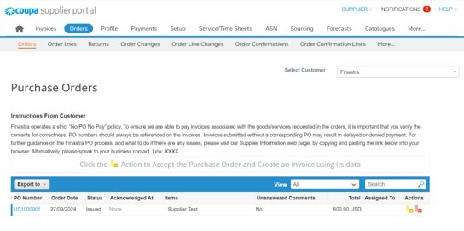
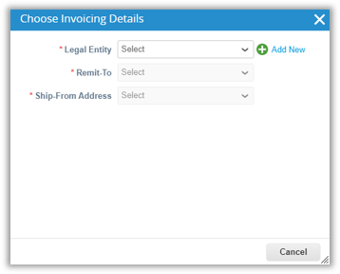
Creating PO-Backed Invoices [1/7]​
To flip a PO into an invoice, login to your CSP account*:​
Select the “Orders” tab.​
Under the “Orders” sub-tab, use the search bar to search for the PO and click on the yellow coins to create an invoice.​
If this is your first time creating an invoice, a pop-up screen will prompt you to select a “Legal Entity”, “Remit-To”, and “Ship-From Address”**.
* If you are to invoice a Finastra India entity, please send your legal invoice to the AP mailbox directly.
** Please note: you will need to set up your legal entity in CSP to be able to create an invoice. For further information, please refer to training pack 1. Setting Up CSP Account.

Slide 5
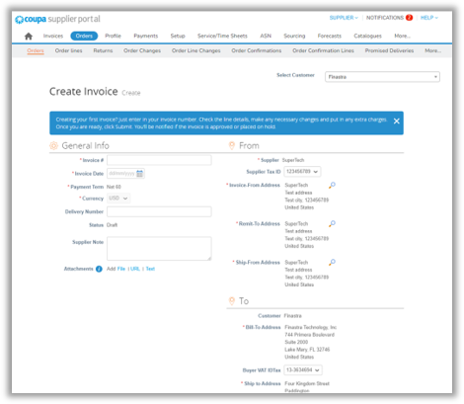
Creating PO-Backed Invoices [2/7]​
On the invoice creation page:​
In the “General Info” section: ​
Complete the “Invoice #” and the “Invoice Date” fields by referring to your legal invoice generated in your own ERP system.​
Attach your supporting documents in the “Attachments” field – please note: since Coupa will generate a legal invoice on your behalf, you should not attach your legal invoice as your attachments here; otherwise, it will be counted as double invoicing.​
In the “From” and the “To” sections: ​
Confirm the pre-populated details – please note: details in those sections will be defaulted from your legal entity setup in CSP and the PO. ​
To change the Invoice-From/Remit-To/Ship-From addresses, click the magnifying glass icon – please note: you will need to complete your e-invoicing setup to make addresses selectable for each fields.
Please refer to 05 Tax Guidance section if you need any guidance on how to choose the correct Tax ID.​

Slide 6
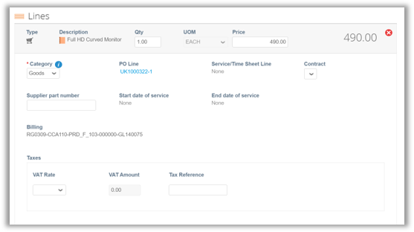
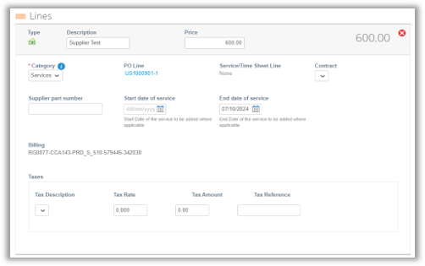
Creating PO-Backed Invoices [3/7]​
On the same page, scroll down to the “Lines” section:​
Review the pre-populated fields which has been defaulted from the PO and edit if needed.​
For partial invoice, if the PO is:​
- Quantity-based (i.e. the “Category” is Goods), edit the “Qty” and/or the “Price” field;​
- Amount-based (i.e. the “Category” is Services), edit the “Price” field.​
To delete lines, click on the “x” icon.
An example of a quantity-based line:
An example of an amount-based line:

Slide 7
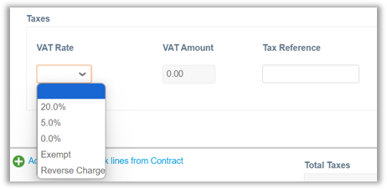
Creating PO-Backed Invoices [4/7]​
In the “Lines” section and “Taxes” subsection:​
Select or populate the tax rate for each line item if applicable.​
It is important to ensure the tax details you populate in this subsection align with any tax information you have provided when setting up your CSP account – e.g. taxes should be applied based on the country of the legal entity.​
Please note: depending on the country, the “Taxes” subsection may be different and have different options*.
An example for a UK PO line:​
An example for a US PO line:​

Slide 8
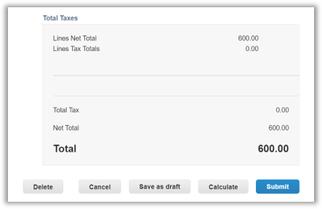
Creating PO-Backed Invoices [5/7]​
On the same page, scroll down to the summary:​
Click on “Calculate” to refresh the price calculation.​
To save the invoice for later, click “Save as draft”.​
To submit the invoice, click “Submit”.​
After clicking “Submit”, a pop-up confirmation window will appear – click “Send Invoice” when ready.

Slide 9
Creating PO-Backed Invoices [6/7]​
To add comments on the invoice, scroll down and use the “Comments” section on the Invoice creation page:​
Populate your comments and click “Add Comment”, it will be directly sent to Finastra requester.​
Use the @name functionality to send comments to additional Finastra users.​
Once the response from Finastra is available, you will receive a notification and will be able to see responses in this section.

Slide 10
Creating PO-Backed Invoices [7/7]​
Key Notes on PO-Backed Invoice Creation:​
Coupa’s Compliance-as-a Service (CaaS) for e-invoicing is a part of Coupa’s Invoicing product that de-risks invoicing for your business by providing compliance support with local regulatory invoicing requirements in supported countries*. ​
For Coupa’s compliant e-invoicing countries, you should not attach the invoice generated from your ERP system – as Coupa will detect them as duplicate invoices.​
Please note: the CaaS is turned off for India suppliers, so if you need to invoice against a non-India Finastra entity in CSP, you should attach your legal invoice in the “Attachments” field in the invoice creation page, as Coupa will not be generating the legal document for you.
* Please find the list of Coupa compliant e-invoicing countries in 06 Additional Information section.

Slide 11
Creating PO- Backed Credit Notes​
2

Slide 12
Creating PO-Backed Credit Notes [1/7]​
To flip a PO into a Credit Note, login to your CSP account:​
Select the “Orders” tab.​
Under the “Orders” sub-tab, use the search bar to search for the PO and click on the red coins to create a credit note.

Slide 13
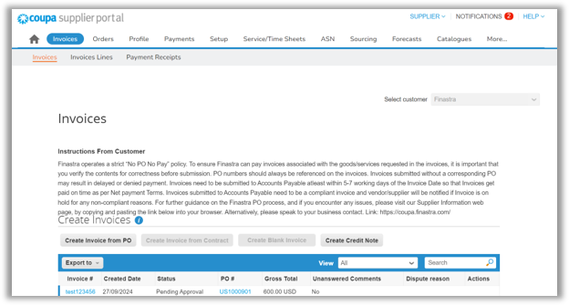
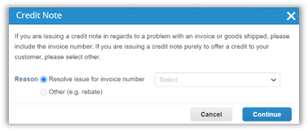
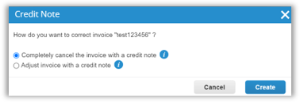
Creating PO-Backed Credit Notes [2/7]​
Alternatively, click the “Invoices” tab:​
Click on the “Create Credit Note” button.​
A pop-up window will appear:​
To correct an original invoice, click the “Resolve issue for invoice number” option and select the invoice number using the dropdown – once ready, click “Continue”.​
On the same pop-up window, select whether you are to create a full/partial credit note, and click “Create”.​.

Slide 14
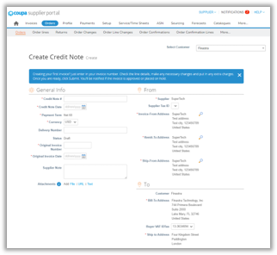
Creating PO-Backed Credit Notes [3/7]​
On the credit note creation page:​
Complete the required fields in the “General Info” section – i.e. “Credit Note #” and “Credit Note Date”.​
Review and update the fields in the “From” and “To” sections:​
To create a credit note against an existing invoice, you should ensure the information in the “From” and “To” sections for credit note creation aligns with the invoice details.

Slide 15
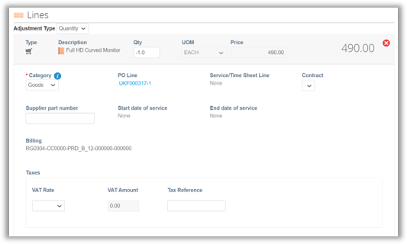
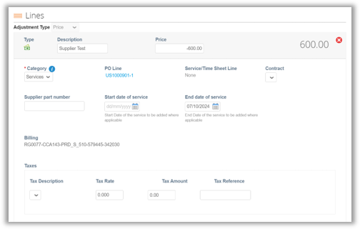
Creating PO-Backed Credit Notes [4/7]​
On the same page, scroll down to the “Lines” section:​
Review the pre-populated fields and edit if needed.​
Ensure the value in the “Price” or “Qty” field is negative, if the PO is:​
- Quantity-based (i.e. the “Category” is Goods), edit the “Qty” field and/or the “Price” field.​
- Amount-based (i.e. the “Category” is Services), edit the “Price” field.​
To delete lines, click on the “x” icon.
An example of a quantity-based line:
An example of an amount-based line:

Slide 16
Creating PO-Backed Credit Notes [5/7]​
In the “Lines” section and “Taxes” subsection:​
Select or populate the tax rate for each line item if applicable.​
It is important to ensure the tax details you populate in this subsection align with any tax information you have provided when setting up your CSP account – e.g. taxes should be applied based on the country of the legal entity.​
Please note: depending on the invoicing country, the “Taxes” subsection may be different and have different options*.
An example of a quantity-based line:
An example of an amount-based line:
* Please refer to 05 Tax Guidance section if you need any guidance on how to choose the correct Tax ID.

Slide 17
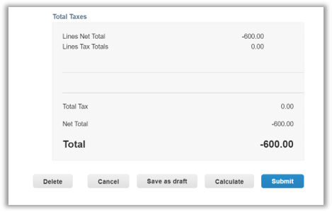
Creating PO-Backed Credit Notes [6/7]​
On the same page, scroll down to the summary:​
Click on “Calculate” to refresh the price calculation – and you will see the refreshed total in negative value.​
To save the credit note for later, click “Save as draft”.​
To submit the credit note, click “Submit”.​
After clicking “Submit”, a disclaimer will appear – click “Send Credit Note” when ready.

Slide 18
Creating PO-Backed Credit Notes [7/7]​
To add comments on the credit note, scroll down and use the “Comments” section on the Credit Note creation page:​
Populate your comments and click “Add Comment”, it will be directly sent to Finastra requester.​
Use the @name functionality to send comments to additional Finastra users.​
Once the response from Finastra is available, you will receive a notification and will be able to see responses in this section.

Slide 19
Viewing Invoices & Credit Notes
3

Slide 20
Viewing Invoices & Credit Notes [1/2]​
To view the general info of the invoice/credit note, login to your CSP account:​
Select the “Invoices” tab. Under the “Invoices” sub-tab, use the search bar to search for the invoice/credit note.​
You will see general info of the invoice/credit note, e.g. “Created Date” and “Status”.​
The “Status” can be any of the below:​
Status​ | Definition​
Abandoned​ | This status indicates the disputed invoice has been abandoned.​
Approved​ | This status indicates the invoice/credit note has been accepted for payment by Finastra.​
Disputed​ | This status indicates the invoice/credit note has been disputed by Finastra. You will need to review comments and action to resolve the dispute.​
Draft​ | This status indicates the invoice/credit note is saved in draft and has not been submitted yet.​
Invalid​ | This status is specific for compliant e-invoices for clearance countries. It indicates the compliant invoices submitted have incorrect or incomplete information and therefore have been moved to a permanent Invalid state.​
Pending Approval​ | This status indicates the invoice/credit note is currently under review by Finastra.​
Processing​ | This status indicates the invoice/credit note is being processed by Finastra’s Accounts Payable department.​
Voided​ | This status indicates there is an issue with the invoice/credit note and hence it is cancelled.​

Slide 21
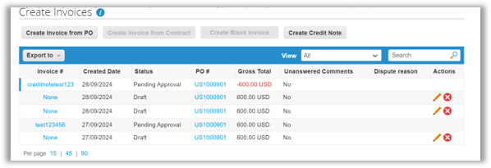
Viewing Invoices & Credit Notes [2/2]​
To view the payment details and the history of the invoice/credit note, click into to the invoice/credit note:​
Scroll down to the bottom of the page:​
Unfold the “Payments” section to view payment details;​
Unfold the “History” section to view the audit trail of all changes applied to the invoice/credit note.

Slide 22
4
Creating Reports & Downloading Invoices​

Slide 23
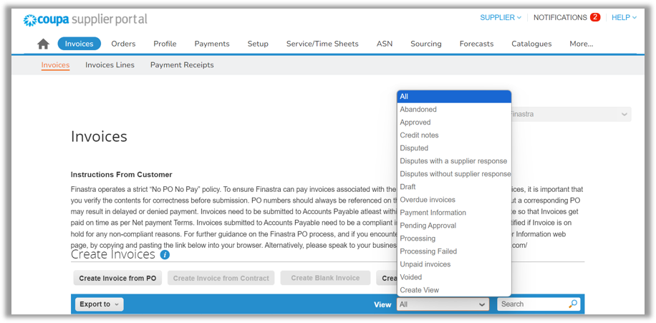
Creating Reports & Downloading Invoices [1/5]​
To create a custom report for invoices, login to your CSP account:​
Select the “Invoices” tab.​
Under the “Invoices” sub-tab, use the “View” dropdown to “Create View”.

Slide 24
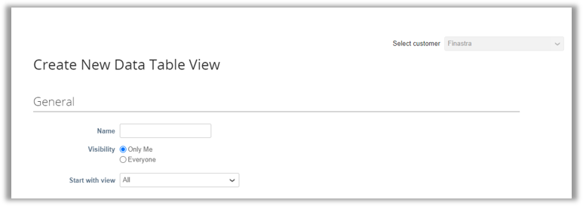
Creating Reports & Downloading Invoices [2/5]​
On the custom view creation page:​
Ensure to select “Finastra” in the “Select customer” dropdown.​
Complete the fields in the “General” section:​
“Name”: populate the report name – Please note: this field has a 30-character limit.​
“Visibility”: set the report visibility to “Only Me” or “Everyone”.​
“Start with view”: select the view as a starting condition for your report.

Slide 25
Creating Reports & Downloading Invoices [3/5]​
Scroll down and complete the “Conditions” section:​
To set up conditions for one condition line, use the “Match Conditions” dropdown to: ​
Select “Match all conditions” to filter out the results that match all conditions;​
Or select “Match at least one condition” to filter out the results that match any conditions.
To set up conditions for multiple condition lines:​
Click “Add group of conditions” or the green plus icon – a new line will appear under the first condition line.​
Select “Match at least one condition from every group” to set up the “AND” function or select “Match all conditions from at least one group” to set up the “OR” function.​

Slide 26
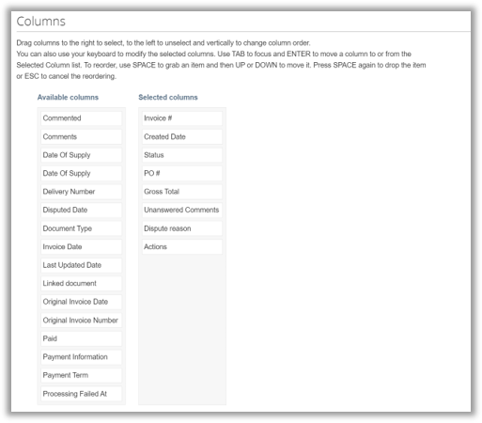
Creating Reports & Downloading Invoices [4/5]​
After completing the “Conditions” section, scroll down to the “Columns” section and set up the displayable fields in the report:​
To include fields in the report, drag and drop fields under the “Selected columns”;​
To unselect fields, drag and drop them under the “Available columns”.
​

Slide 27
Creating Reports & Downloading Invoices [5/5]​
After selecting the needed fields, scroll down to the “Default Sort Order”:​
Use the “Sort by” field to sort the order of the invoice/credit note display.​
Click “Save” to save the view.
Once the custom view has been created:​
To download a report with the newly customised view: ​
Select the view use the “View” dropdown and click the “Export to” dropdown to download a report in “CSV for Excel (current columns)” format.​
Coupa stores all the invoices that you have created. To download the invoices, use the “View” field or the search bar to filter out the invoices and click the “Export to” dropdown to download the “Legal Invoice (zip)”.

Slide 28
Tax Guidance
5

Slide 29
Tax Guidance​
Guidance on choosing the correct Tax ID:​
Your Tax ID in the legal invoice that Coupa generates on your behalf is driven by your Remit to Address (RTA) set up in the CSP.​
Therefore, if your business is tax registered in multiple countries, you will need to ensure to set up the correct Tax ID against each RTA in CSP.​
You should ensure the correct tax is charged on your invoice. ​
Depending on the invoicing country, you will have different available fields to populate your tax information. For instance, if you are a UK supplier, you will be able to choose the VAT rates with available options, e.g. 5% and 20%, when creating your invoice.​
Please find below some high-level guidance on how to select the correct Tax ID:​
If tax is applicable​ | If tax is not applicable​
If you are charging tax on your supply (including tax at a reduced or zero-rate):​ Your Tax ID should match the country where tax is being charged.​ For example, if you have imported goods into the UK and you will charge UK VAT, and you will need to populate your UK VAT ID.​ | If you are not charging tax on your supply:​ If goods are being supplied to a customer located in a different country, your tax ID (if applicable) normally matches the country where the goods are being shipped from.​ If services are being provided, your tax ID country will normally match the country where your establishment providing the services is located.​ If you are not sure of the correct VAT ID to use for your supply, please seek help from your tax team or the local tax authorities as appropriate. ​

Slide 30
Additional Information
6

Slide 31
Additional Information​​
Below are the list of countries which are supported by Coupa’s Compliant E-invoicing:​
Note: Further details can be found on Coupa Compass: List of Supported CaaS Countries | Coupa​
Australia​ | Finland​ | Malta​ | Singapore​
Austria​ | France​ | Mexico​ | Slovakia​
Bahrain​ | Germany​ | Montenegro​ | Slovenia​
Bangladesh​ | Greece​ | Myanmar​ | South Africa​
Belgium​ | Hong Kong​ | Namibia​ | South Korea​
Brazil​ | Hungary​ | Netherlands​ | Spain​
Bulgaria​ | India​ | New Zealand​ | Sweden​
Canada​ | Ireland​ | Norway​ | Switzerland​
China​ | Italy​ | Pakistan​ | United Arab Emirates​
Colombia​ | Japan​ | Poland​ | UK​
Croatia​ | Latvia​ | Portugal​ | USA​
Czech Republic​ | Lithuania​ | Romania​ | ​
Denmark​ | Luxembourg​ | Saudi Arabia ​ | ​
Estonia​ | Malaysia​ | Serbia​ | ​

Slide 32
Thank you! FINANCE IS OPEN
Finastra unlocks innovation across the world of financial services, through our trusted software and open platform.

