Slide 1
Registering for the Coupa Supplier Portal (CSP)
FINANCE IS OPEN

Slide 2
Contents
1
Registering for the Coupa Supplier Portal (CSP)​
4
Setting Up Legal Entity Information​
2
Navigating the CSP​
5
Managing Remit-To Accounts​
Inviting Additional Team Members ​
6
Managing Notifications ​
3
7
Additional Information​

Slide 3
1
Registering for the Coupa Supplier Portal (CSP)​

Slide 4
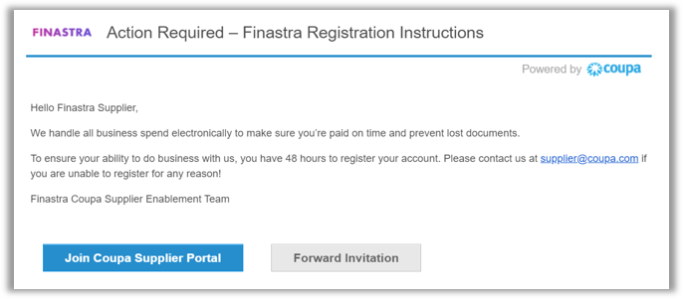
CSP Registration [1/3]
Coupa Supplier Portal Registration:
You will receive a Coupa Supplier Portal (CSP) invite from Finastra via email.
If you are a new Coupa user [1/2]:
Click “Join Coupa Supplier Portal” in your email.
After being directed to the CSP website, input the required credentials to complete your CSP registration.

Slide 5
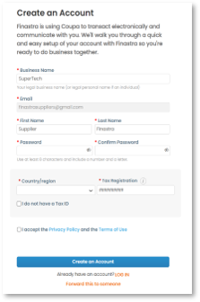
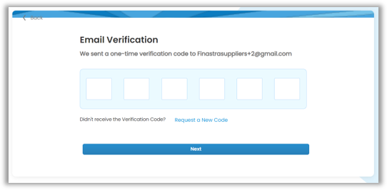
CSP Registration [2/3]
If you are a new Coupa user [2/2]:​
Input your “Business name” and create a “Password”.​
As a new Coupa user, you will also be asked to “accept the Privacy Policy and the Terms of Use” – please access via the hyperlinks and read and confirm accordingly.​
Click on “Create an Account”, which will direct you to a new page for email verification.​
Input the verification code you will have received via email, and click “Next” to access the Coupa Supplier Portal.

Slide 6
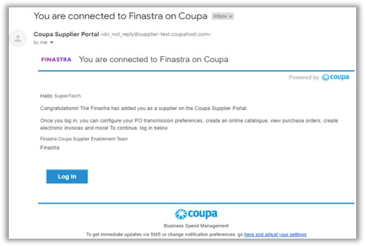
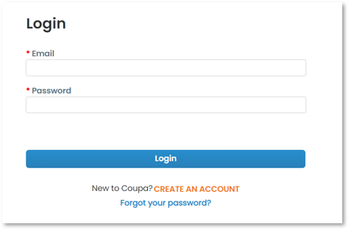
CSP Registration [3/3]
If you already have an account:​
Click “Login” to navigate to the Login page.​
Input your “Email” and “Password”, and click “Login” to access the Coupa Supplier Portal.

Slide 7
Navigating the CSP​
2

Slide 8
Navigating the CSP: Homepage Overview [1/2]​
1
2
3
41
5
6
71
8
#​ | Item Name​ | Description​
1​ | Account​ | Your account name with an associated drop down sub-menu – to manage your CSP account.​
2​ | Notifications​ | To view notifications and manage notification preferences.​
3​ | Help​ | To access the CSP help sub-menu: ​ Coupa Compass: where you can find resources, such as support articles, to better use Coupa.​ Training Webinars: where you can register for a supplier training webinar.​ Help Tour: of the open page in question.​
4​ | Home​ | To navigate to the CSP homepage.​
5​ | Profile​ | To manage your profile information.​
6​ | Orders​ | To access and manage Purchase Orders.​
7​ | Invoices​ | To access, manage, and create Invoices.​
8​ | Setup​ | To manage Admin tasks.​

Slide 9
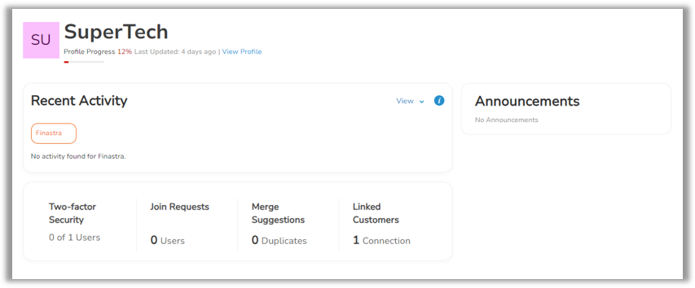
Navigating the CSP: Homepage Overview [2/2]​
Item Name​ | Description​
Two-factor Security​ | Number of users who have completed the two-factor authentication setup.​
Join Requests​ | Requests from new users to access this account.​
Merge Suggestions​ | Suggestions to merge multiple CSP accounts with the same confirmed email domain.​
Linked Customers​ | Number of your trading customers on Coupa.​

Slide 10
Inviting Additional Team Members ​
3

Slide 11
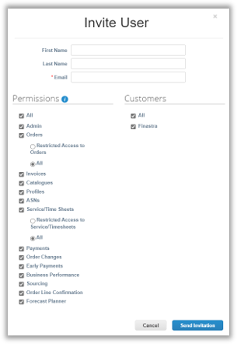
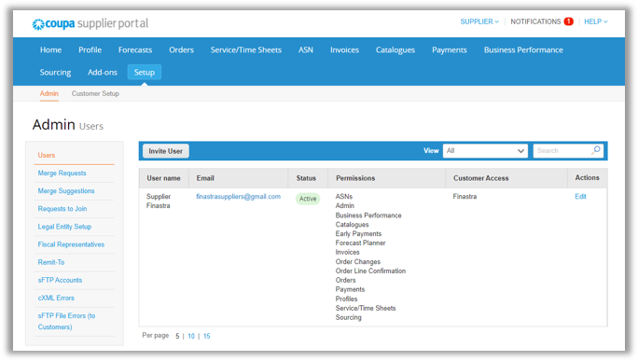
Inviting Additional Team Members [1/2]​
Please note: only CSP users with an Admin role will have permission to invite users.​
To invite an additional user:​
Click “Setup” and “Invite User” in the Users section.​
On the pop-up “Invite User” screen, input the required information.

Slide 12
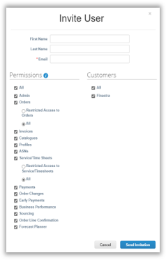
Inviting Additional Team Members [2/2]​
Complete the required information on the “Invite User” screen:​
Input the user’s name and email address.​
Check/uncheck appropriately the fields in the “Permissions” and “Customers” sections to control the new user’s permissions and access.​
Once complete, click “Send Invitation”, which will issue an email invitation to the new user. The new user will need to go through the same registration and log-in process, as previously described, in order to access the CSP.

Slide 13
Setting Up Legal Entity Information​
4

Slide 14
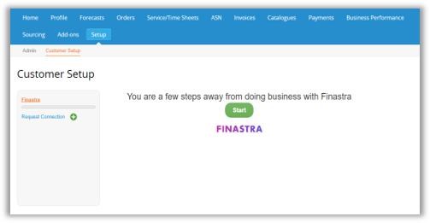
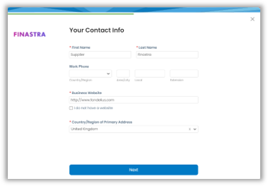
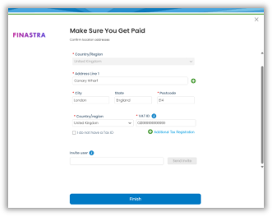
Setting Up Legal Entity Information [1/8]​
On the CSP Homepage, click “Setup”:​
Click the sub-menu “Customer Setup”, edit and confirm your contact info on the pop-up screen.​
If you close the pop-up screen by accident, click the “Start” button to re-access it. ​
The contact info is initially auto-populated with the details provided during CSP registration. ​
Once confirmed, click on “Next” to continue.​
In the “Make Sure You Get Paid” page, review and amend the auto-populated details provided during CSP registration, as required.​
Click “Finish” once complete.

Slide 15
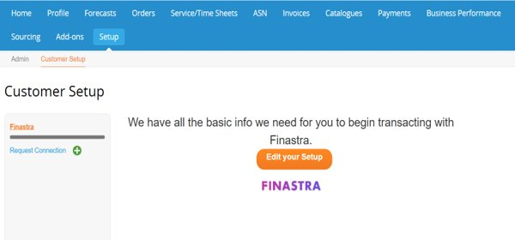
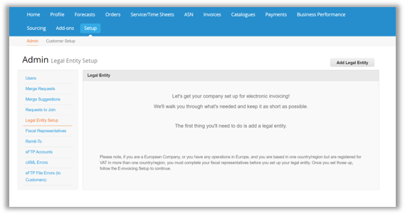
Setting Up Legal Entity Information [2/8]​
On the “Customer Setup” page:​
Click the “Edit your Setup” button and you will be directed to the “Legal Entity Setup” section under the “Admin” sub-menu. ​
Click on the “Add Legal Entity” button, and complete the required legal entity information within the pop-up window.

Slide 16
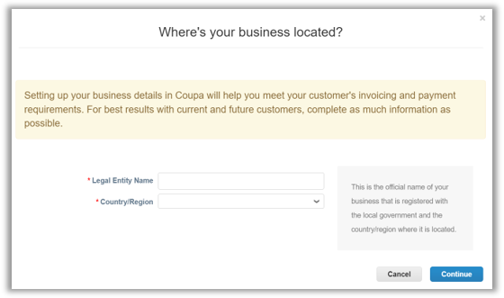
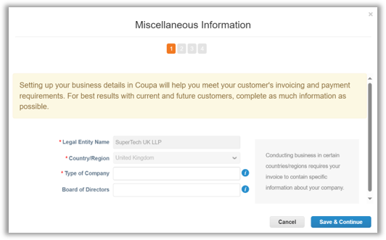
Setting Up Legal Entity Information [3/8]​
On the “Where’s your business located?” pop-up screen:​
Complete the “Legal Entity Name” and the “Country/Region” fields.​
Click “Continue” to start the 4-step setup process.​
Step 1: Miscellaneous Information​
Confirm “Type of Company” (mandatory) and names of “Board of Directors” (optional).​
Once complete, click “Save & Continue” to move to Step 2.

Slide 17
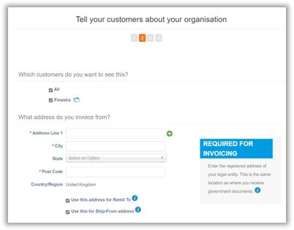
Setting Up Legal Entity Information [4/8]​
Step 2: Tell your customers about your organisation [1/2]:​
In the “Which customers do you want to see this?” section – select the customers to which this legal entity will be visible to.​
In addition to Finastra, if you have any other customers linked to the same CSP account, they will also be selectable in this section. ​
In the “What address do you invoice from?” section – complete your Invoice-From details.​
Tick the checkbox(es) if you want to use the same Invoice-From address for Remit-To and/or Ship-From address(es).

Slide 18
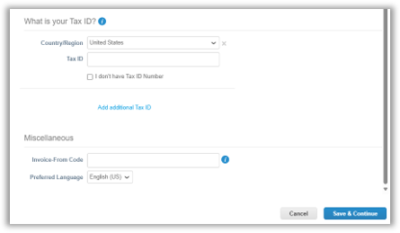
Setting Up Legal Entity Information [5/8]​
Step 2: Tell your customers about your organisation [2/2]:​
In the “What is your Tax ID?” section – select your tax Country/Region and insert your Tax ID.​
If you would like to invoice Finastra using a tax registered in other countries: click “Add additional Tax ID” and provide details.​
If you do not have a Tax ID: check the “I don’t have a Tax ID Number” box and provide your “Local Tax ID”.​
In the “Miscellaneous” section – input your “Invoice-From Code” (Optional) and set up your “Preferred Language” (Optional) in CSP.​
If you will be using cXML for invoicing with Finastra, the “Invoice-From Code” can tie with your registered CSP Invoice-From address with the corresponding address in your ERP. ​
Please note: “Invoice-From Code” is only applicable to suppliers using cXML and should be otherwise left blank.​
Click “Save & Continue” to move to Step 3.

Slide 19
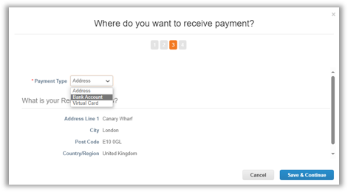
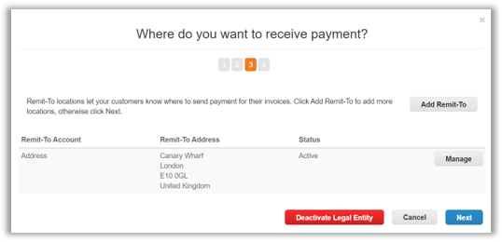
Setting Up Legal Entity Information [6/8]​
Step 3: Where do you want to receive payment?​
Select your “Payment Type” – Address or Bank Account:​
For Address: the Remit-To address is auto-populated if it has been previously provided – you can deactivate or add additional Remit-To addresses, if required.​
For Bank Account: complete your banking details, such as account number and sort code. Remit-To address information will be automatically pre-populated if it has been provided previously.​
Please note: Virtual Cards should not be used with Finastra, as it is not an available payment type.​
Click “Save & Continue” once complete, and click “Next” to continue with the final step.

Slide 20
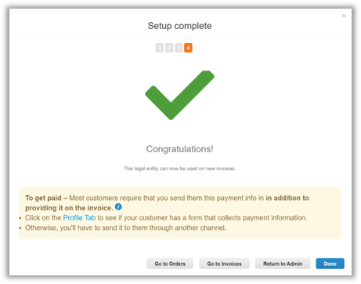
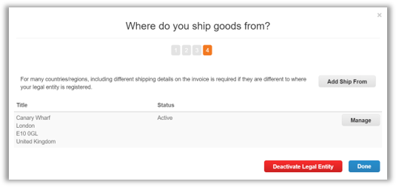
Setting Up Legal Entity Information [7/8]​
Step 4: Where do you ship goods from?​
Manage your shipping details in Step 4:​
The Ship-From address will be auto-populated if it has been provided during previous Steps.​
To add a new Ship-From address, click “Add Ship From” and complete the new Ship-From details.​
Click “Done” to complete the legal entity setup.

Slide 21
Setting Up Legal Entity Information [8/8]​
Additional notes to:​
Page 14 – Customer Setup:​
You should ensure that your tax registration number is correct and relates to the country specified – as this information will be used by Coupa to generate a legal invoice on your behalf.​
Page 17 & 18 – Tell your customers about your organisation:​
If you use cXML for invoicing, it is highly recommended that you input and then subsequently reference the “Invoice-From Code” in your cXML invoices – the code will be provided by Finastra. This will increase the likelihood of a successful cXML invoice transaction as a result of the addresses matching between the CSP and your ERP.​
If you have ticked the boxes to use the Invoice-From address for Remit-To and/or Ship-From addresses, they will have the same code as the “Invoice-From Code”.​
Page 20 – Where do your ship goods from?:​
From a tax perspective, it is critical that Ship-From information is accurate – especially when the Ship-From address is in a different country to the registration country of your legal entity.​
For instance, if you are registered in the UK but your goods will be shipped from a warehouse in India, you will need to add that India warehouse address to ensure that the invoice can be created accurately.

Slide 22
Managing Remit-To Accounts
5

Slide 23
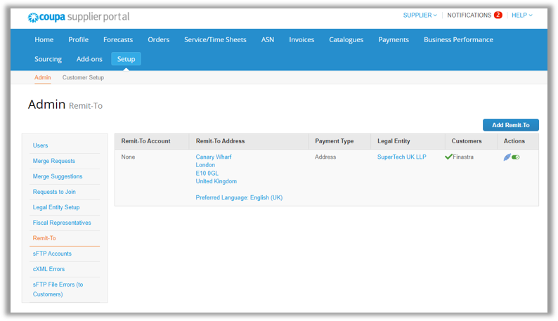
Managing Remit-To Accounts [1/6]​
On the CSP homepage, click “Setup”, and in the “Admin” sub-menu:​
Click “Remit-To” to check all your created Remit-To accounts – here, you can also edit, deactivate, and add your Remit-To accounts.

Slide 24
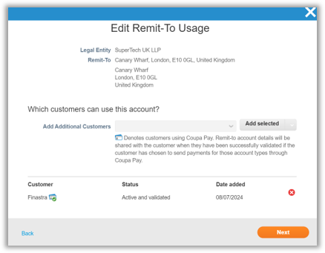
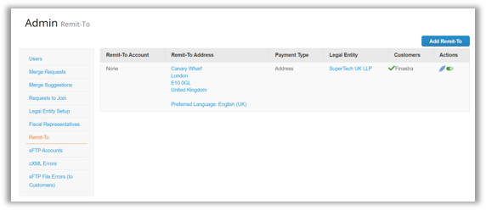
Managing Remit-To Accounts [2/6]​
To edit Remit-To usage (i.e. adding and/or removing customer(s) to this Remit-To account):
​
Click the edit icon.​
In the “Edit Remit-To Usage” pop-up screen:​
To add additional customers to the same Remit-To account: select the corresponding customer account from the “Add Additional Customers” drop down and click “Add selected”.​
To remove an existing customer from the Remit-To account: click the delete icon.​
Click the “Next” button to save all the changes made.

Slide 25
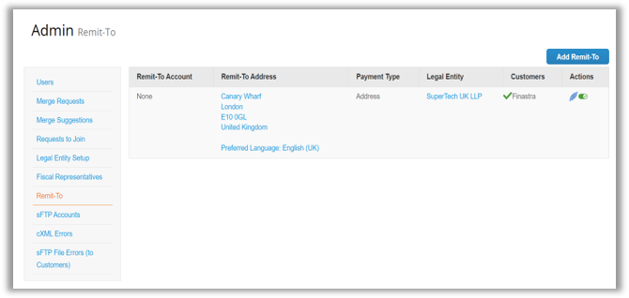
Managing Remit-To Accounts [3/6]​
To deactivate a Remit-To account:​
Click the switch icon to deactivate the Remit-To account.​
Please note: once a Remit-To account is deactivated, it cannot be reversed. Coupa only retains the inactive Remit-To account for audit purposes.

Slide 26
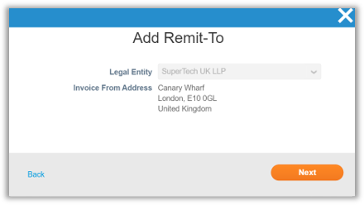
Managing Remit-To Accounts [4/6]​
To add a Remit-To account [1/3]:​
Click “Add Remit-To” button and an “Add Remit-To” screen will pop up.​
In the “Add Remit-To” pop-up screen, check the legal entity details to which you want to add a new Remit-To account. ​
Once confirmed, click the “Next” button to move to the next page.

Slide 27
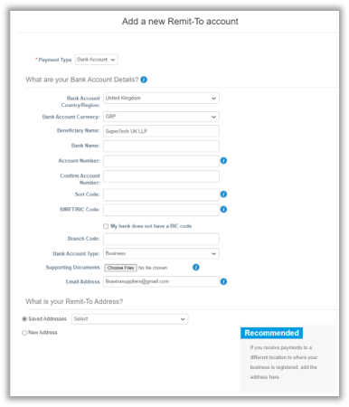
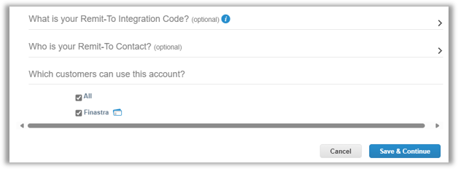
Managing Remit-To Accounts [5/6]​
To add a Remit-To account [2/3]:​
On the “Add a new Remit-To account” page, select the “Payment Type” and complete all the required fields.​
Once complete, click on the “Save & Continue” button.

Slide 28
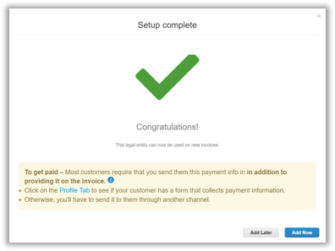
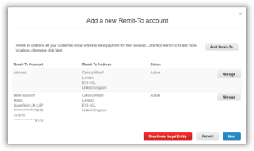
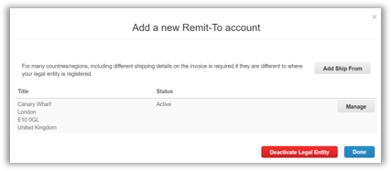
Managing Remit-To Accounts [6/6]​
To add a Remit-To account [3/3]:​
On the “Add a new Remit-To account” page, you will see the “Remit-To Account” you have just added.​
Click on “Next” to manage the Ship-From info.​
Click on “Done” once ready.​
Click on “Add Now” on the final “Setup complete” page to save the change.

Slide 29
Managing Notifications ​
6

Slide 30
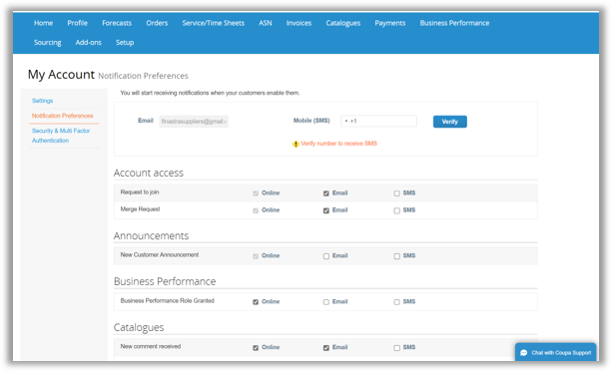
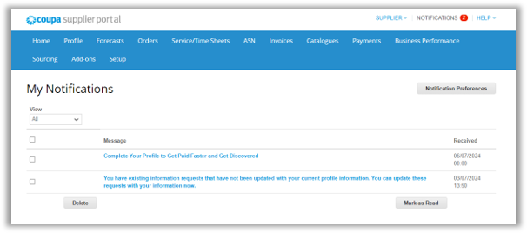
Managing Notifications​
On the CSP homepage:​
Manage your notifications by clicking “NOTIFICATIONS” at the top of your screen.​
Click “Notification Preferences”.​
On the “Notification Preferences” page, enable/disable “Online”, “Email”, and “SMS” notifications.​
Once complete, click “Save” at the bottom of the page to confirm your notification settings.

Slide 31
Additional Information ​
7

Slide 32
Additional Information​
Below are the list of countries which are supported by Coupa’s Compliant E-invoicing:​
Note: Further details can be found on Coupa Compass: List of Supported CaaS Countries | Coupa​
Australia​ | Finland​ | Malta​ | Singapore​
Austria​ | France​ | Mexico​ | Slovakia​
Bahrain​ | Germany​ | Montenegro​ | Slovenia​
Bangladesh​ | Greece​ | Myanmar​ | South Africa​
Belgium​ | Hong Kong​ | Namibia​ | South Korea​
Brazil​ | Hungary​ | Netherlands​ | Spain​
Bulgaria​ | India​ | New Zealand​ | Sweden​
Canada​ | Ireland​ | Norway​ | Switzerland​
China​ | Italy​ | Pakistan​ | United Arab Emirates​
Colombia​ | Japan​ | Poland​ | UK​
Croatia​ | Latvia​ | Portugal​ | USA​
Czech Republic​ | Lithuania​ | Romania​ | ​
Denmark​ | Luxembourg​ | Saudi Arabia ​ | ​
Estonia​ | Malaysia​ | Serbia​ | ​

Slide 33
Thank you! FINANCE IS OPEN
Finastra unlocks innovation across the world of financial services, through our trusted software and open platform.

